Slide 1
IN VIVO SUBJECT-SPECIFIC ESTIMATION OF CERVICAL SPINE DISC MATERIAL PROPERTIES
Dongge Jia¹, Soumaya Ouhsousou¹, Clarissa M. LeVasseur², Jeremy Shaw³, William Anderst², and John C. Brigham¹
¹ Department of Civil and Environmental Engineering, University of Pittsburgh
² Department of Orthopaedic Surgery, University of Pittsburgh
³ Department of Orthopaedic Surgery, University of Pittsburgh Medical Center
Notes:
Anatomical Variations That Can Lead to Spine Surgery at the Wrong Level: Part III Lumbosacral Spine https://www.ncbi.nlm.nih.gov/pmc/articles/PMC7450882/#:~:text=Spine%20surgery%20at%20the%20wrong%20level%20is%20one%20of%20the,in%20legal%20actions%20%5B1%5D. Wrong-level spine surgery: A multicenter retrospective study
https://doi.org/10.1016/j.jos.2023.11.005

Slide 2
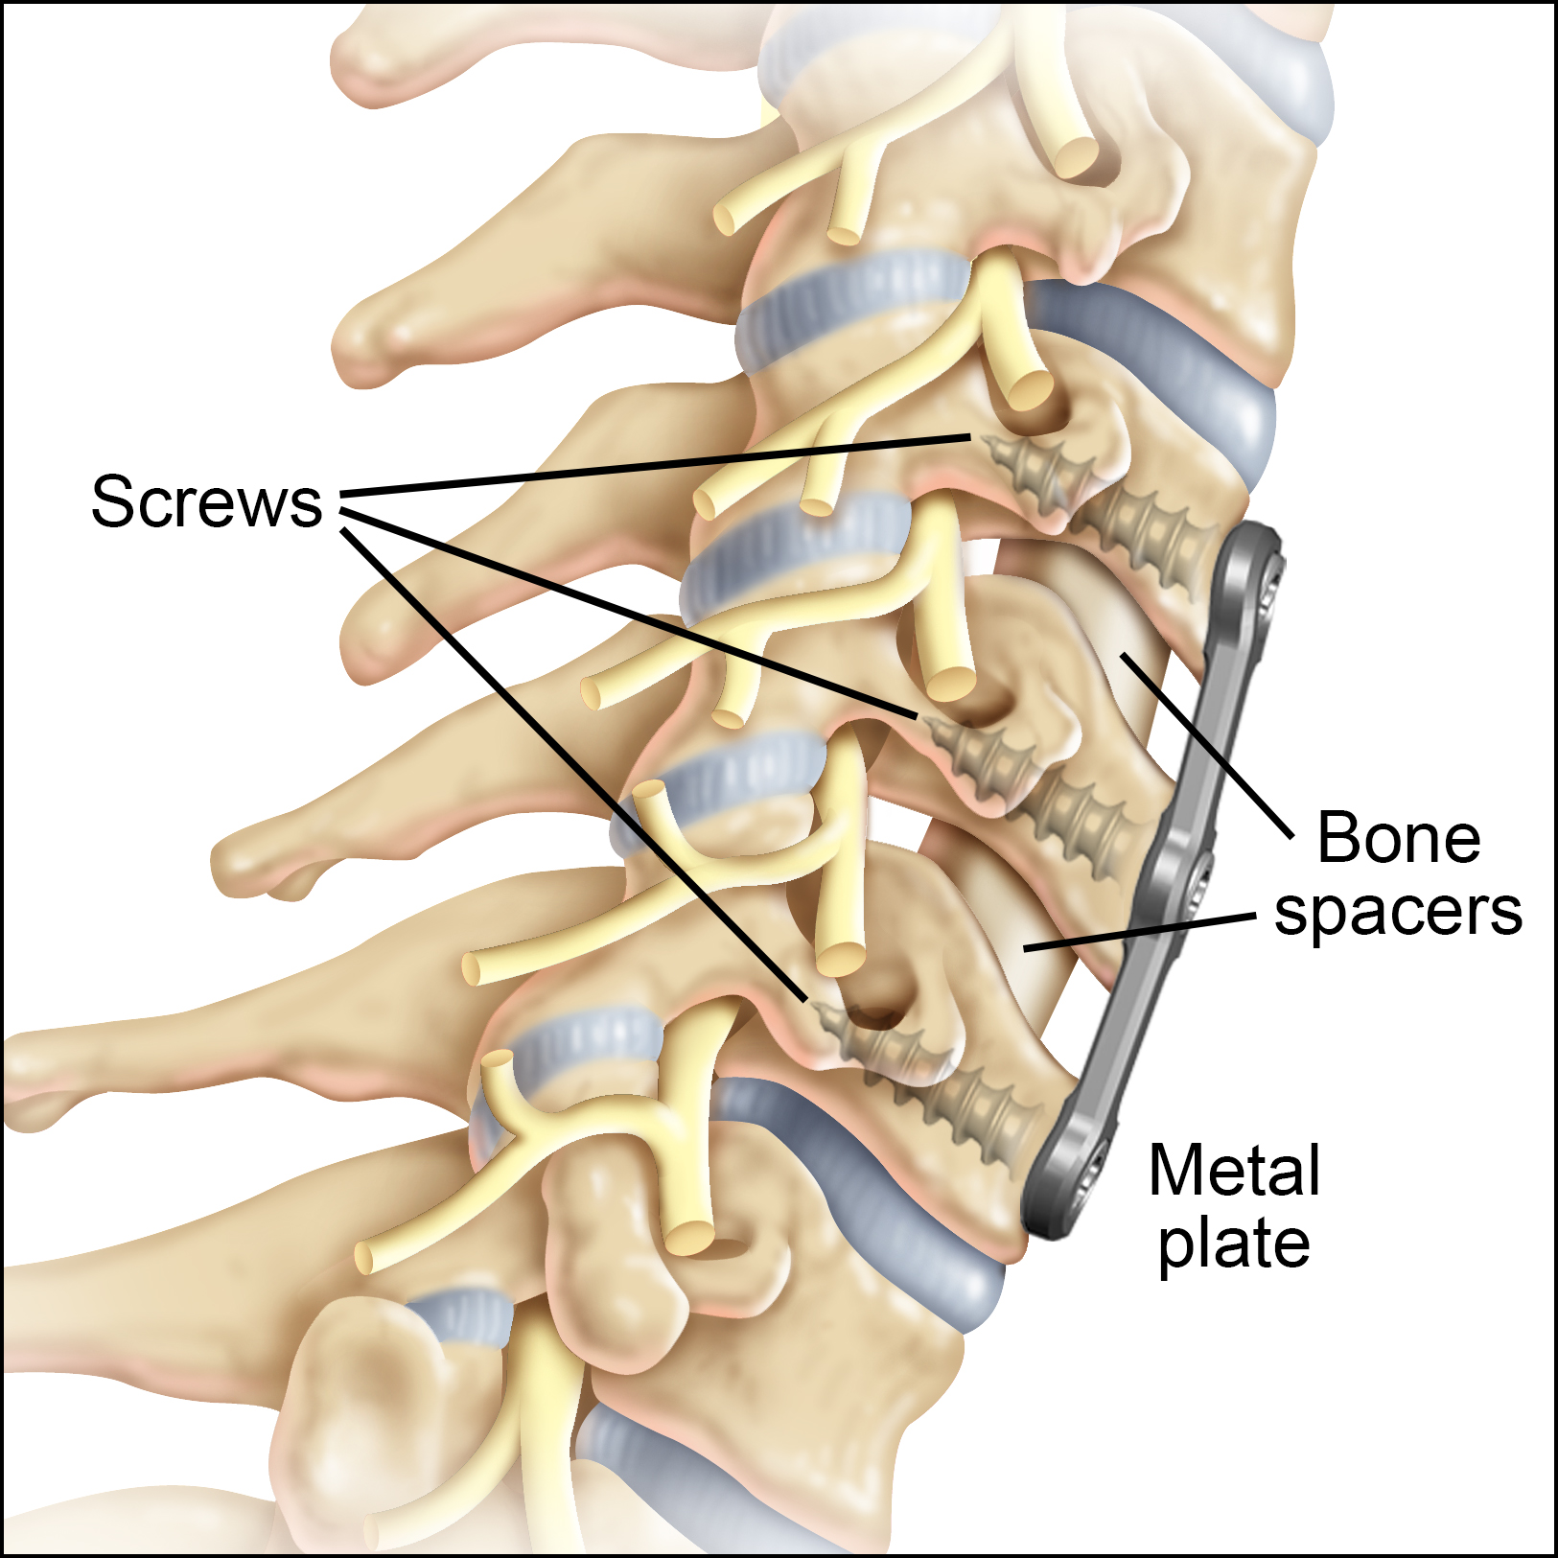
Background & Motivation
~150,000 arthrodesis surgeries in 2020 – 25% are expected to require a 2nd surgery due to adjacent segment disease (ASD).
There is debate whether ASD is caused by excessive motion and disc loading or other patient-specific factors.
A subject-specific computational spine model could help evaluate intervertebral disc degeneration.
No previously developed spine model has been thoroughly validated with in vivo behavior, and instead often only use cadaver models.
Cervical fusion. Degenerated intervertebral discs are replaced by bone spacers and a fusion plate is added to stabilize the spine. The intervertebral disc above and below the fusion are susceptible to degenerative changes after fusion.
Image Source: https://www.cervicaldisc.com/Portals/0/Fusion_1.jpg
Notes:
It was reported that 150000 … degeneration of the adjacent disc has been linked to altered mechanical stresses within the cervical spine due to the fusion.
Degenerative disc disease (DDD) is a common condition that affects the intervertebral discs of the spine, causing pain and discomfort. it's a natural part of the aging process. But it could also be due to genetics, repetitive stress, and injury.
the specific mechanisms behind this phenomenon remain unclear. In order to understand how mechanical stresses change after fusion surgery, it is important to establish an approach …. Knowing that no previously developed …

Slide 3
Research Objective
The overall objective of this work is to identify biomechanical markers/factors that indicate the potential for cervical spine disc degeneration, particularly following spinal fusion surgery.
The current technical objective is to establish a consistent approach to create subject-specific cervical spine computational models, including non-invasively estimated in vivo subject-specific material properties of each disc, using in vivo motion trials of a patient with disc degeneration.
Establish a numerical modeling approach, particularly the required components, to accurately simulate the kinematic response of subject-specific cervical spine.
Estimate subject-specific disc material properties based on in vivo kinematics data.
Notes:
this assumption neglects the heterogeneity among discs which may result in inaccurate predictions.
Therefore, a tool to non-invasively estimate disc stiffness may be valuable for identifying early disc degeneration.

Slide 4
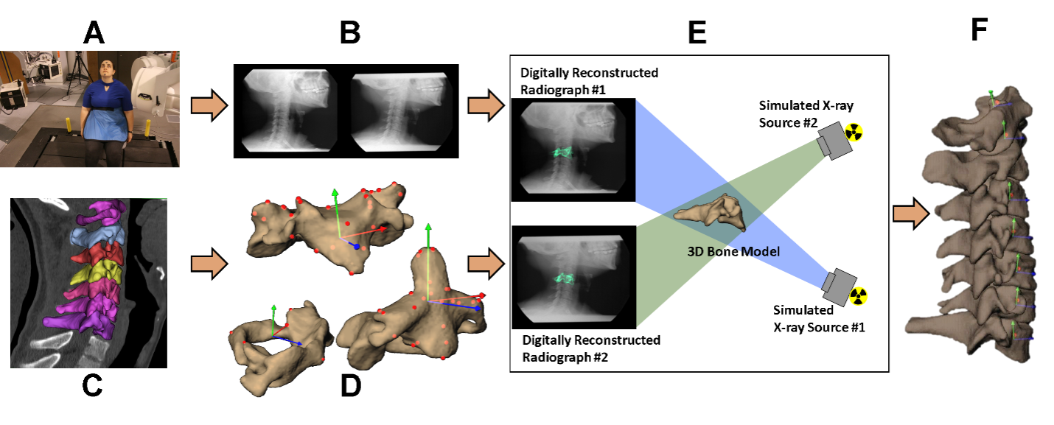
Cervical Vertebrae Geometry from Imaging Data
Our collaborators have a unique toolset to acquire/process the 3D geometry of each vertebra (C2-C7) from high-resolution CT imaging throughout motion experiments.

Slide 5
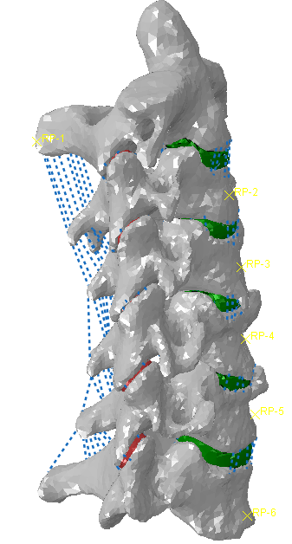
Subject-Specific Cervical Spine Geometry
Ligaments: anterior longitudinal ligament (ALL), posterior
longitudinal ligament (PLL), interspinous ligament (ISL), ligamentum flavum (LF), capsular ligament (CL) are included;
1-D connector element is used to represent the band structure of ligaments.
Vertebrae (including end plates of vertebrae):
Rigid bodies (no material property).
(Palomar at al. 2008, Ha 2006)
Intervertebral disc: the geometry of components are based on the subject-specific spine anatomy.
Facets: the geometry is based on the subject-specific spine anatomy.
Notes:
Based on these two assumptions, we build a nonlinear model through a careful and rigorous literature review. So from this page to the end, all considerations for each component in the model is based on the up-to-date experimental findings in literature.
The first consideration is how to model vertebrae. In our model, we are focusing on the kinematics cervical spine and the degeneration of intervertebral disks. However, the verterbrae are much more rigid than disks so that its deformation can be neglected compared with the deformation of disks. So we chose to model it as a rigid body that can move in model but neve deform. This significantly increased our model’s computational efficiency.
Similarly, the end plates of vertebrae are assumed to be part of the rigid vertebrae considering that these end plates have a stiffness of the same order of magnitude as the bone.

Slide 6
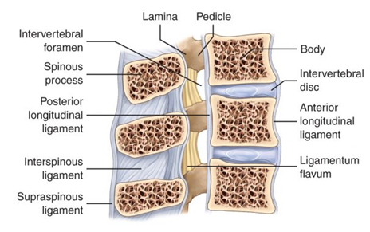
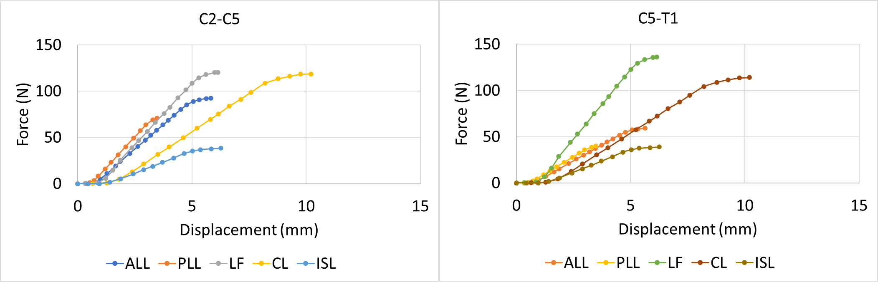
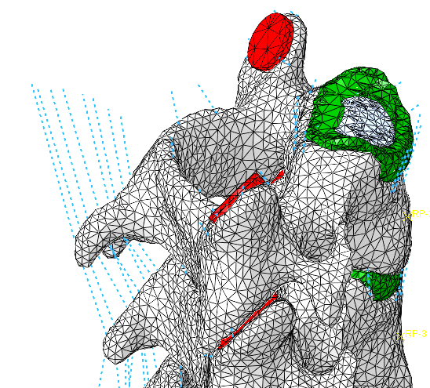
Ligaments
Tension-only nonlinear connectors;
C2-C5 and C5-C7 have distinct properties; Nonlinear force-displacement relations used:
Number of connectors and cross-sectional area
specific to type of ligament (size):
ALL(6);PLL(5);LF(4);CL(5);ISL(8)
(Chazal et al. 1985; Yoganandan at al. 2000; Panzer and Cronin 2009)
C2-C5
C5-C7
LF
PLL
ISL
ALL
CL
Notes:
As for ligaments, we use tension-only nonlinear connectors in abaqus. And based om the experimental finding, the disks between C2 to C5 have a different material property from that between C5-C7. The nonlinear force displacement relations tested from experiments are shown in this picture.
Considering the shape of ligaments which is like sheets covered the vertebrae, multiple connectors are used to represent one type of ligament and a specific cross-section is assigned to each connector.
ALL, anterior longitudinal ligament; PLL, posterior
longitudinal ligament; ISL, interspinous ligament, LF, ligamentum flavum; CL, capsular ligament

Slide 7
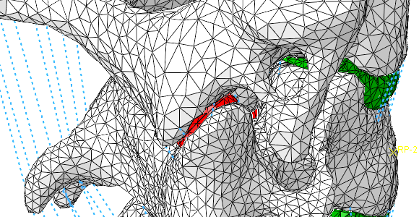
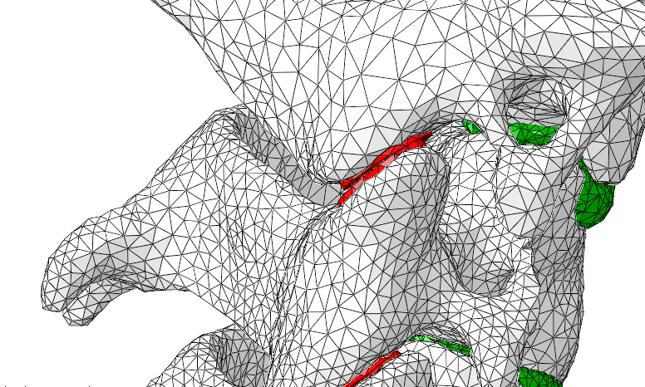
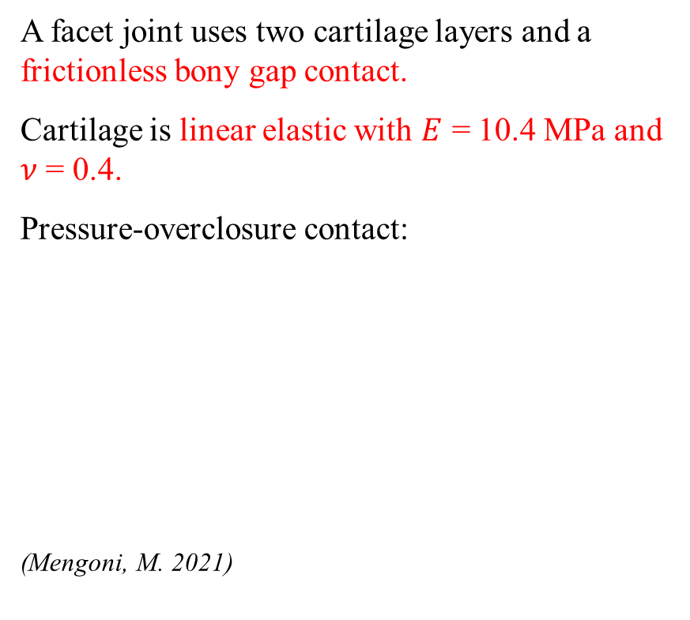
Facet Joints
A facet joint uses two cartilage layers and a frictionless bony gap contact.
Cartilage is linear elastic with $E$ = 10.4 MPa and $ν$ = 0.4.
Pressure-overclosure contact:
(Mengoni, M. 2021)
Contact pressure
Cartilage
Clearance
Overclosure
Bony gap 0.3 mm

Slide 8
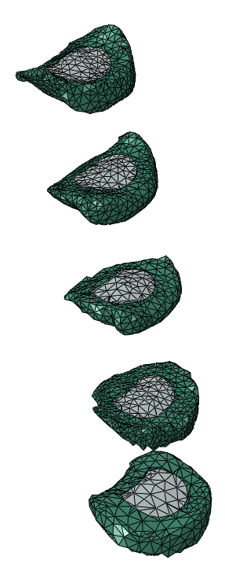
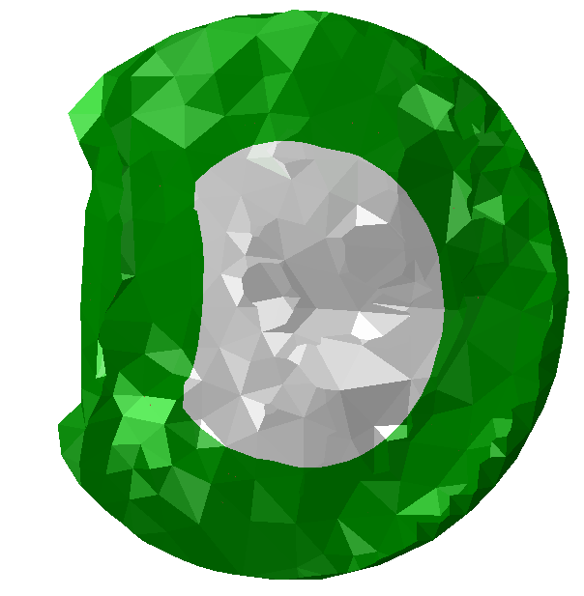
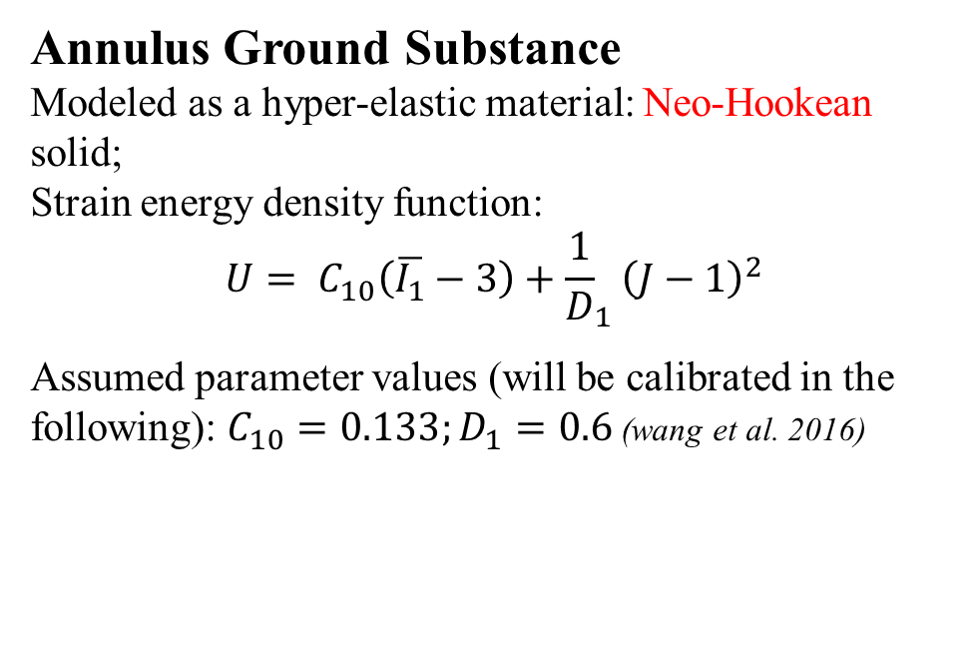
Disc Nuclei and Annulus Ground Substance
Nuclei
Approximately elliptical shape;
Nucleus volume is 40 % - 50 % of the total volume of the disc; (Pooni 1986)
Linear elastic material model with 𝐸 = 2 MPa and 𝜈 = 0.49. (Iatridis 1997; Wang 1997; 2000)
Annulus
Annulus Ground Substance
Modeled as a hyper-elastic material: Neo-Hookean solid;
Strain energy density function:
$${U= C}_{10}\left(\overline{I_{1}}−3\right)+{\frac{1}{D}}_{1}{\left(J−1\right)}^{2}$$
Assumed parameter values (will be calibrated in the following): $C_{10}=0.133;D_{1}=0.6$(wang et al. 2016)
Nucleus
Notes:
Pooni, J. S., Hukins, D. W., Harris, P. F., Hilton, R. C., & Davies, K. E. (1986). Comparison of the structure of human intervertebral discs in the cervical, thoracic and lumbar regions of the spine. Surgical and radiologic anatomy: SRA, 8(3), 175-182.
Wang, J. L., Parnianpour, M., Shirazi-Adl, A., Engin, A. E., Li, S., & Patwardhan, A. (1997). Development and validation of a viscoelastic finite element model of an L2/L3 motion segment. Theoretical and applied fracture mechanics, 28(1), 81-93.

Slide 9
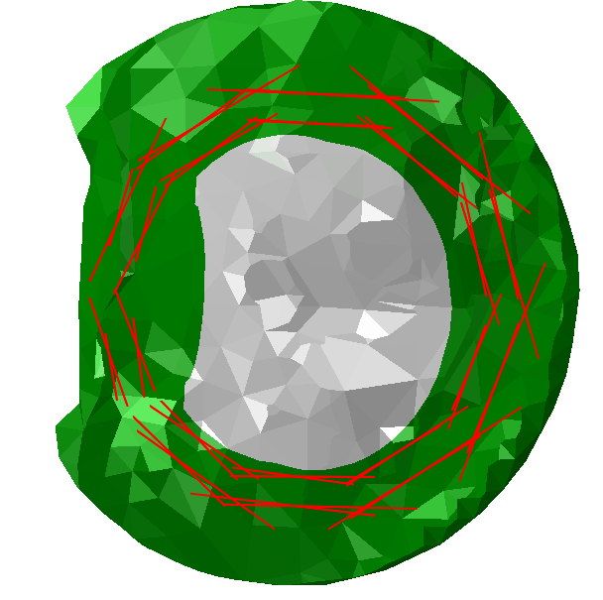
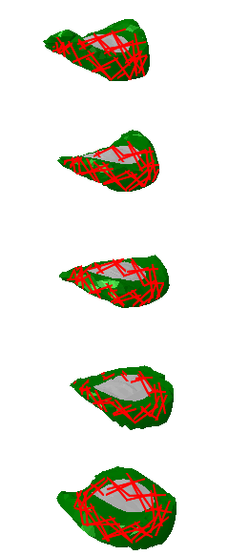
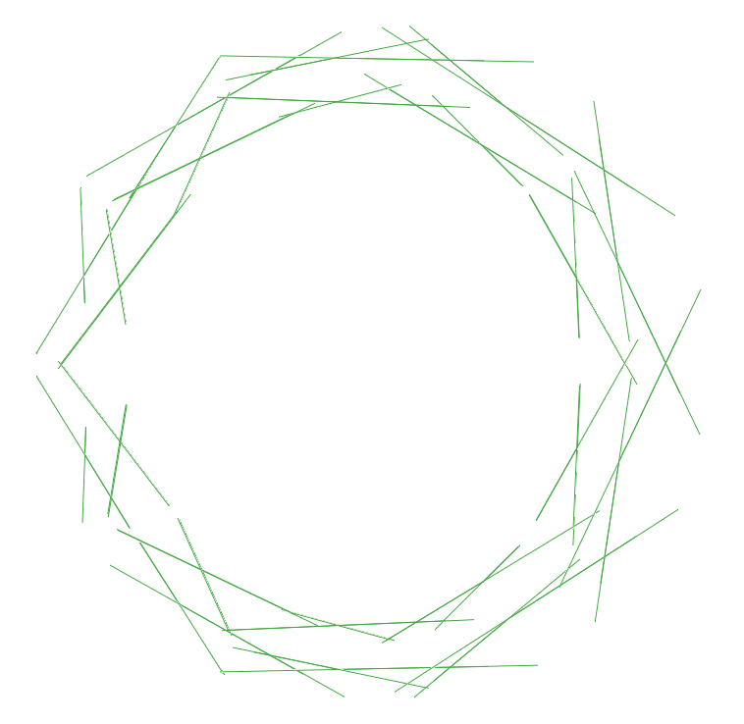
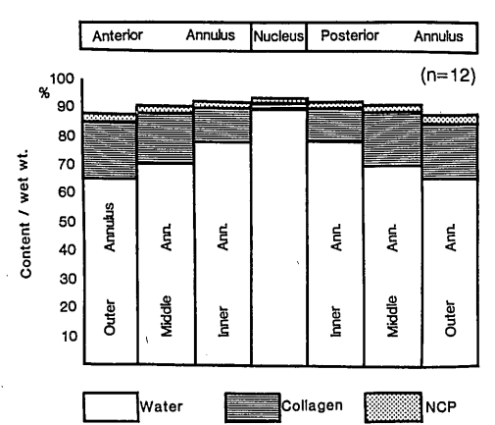
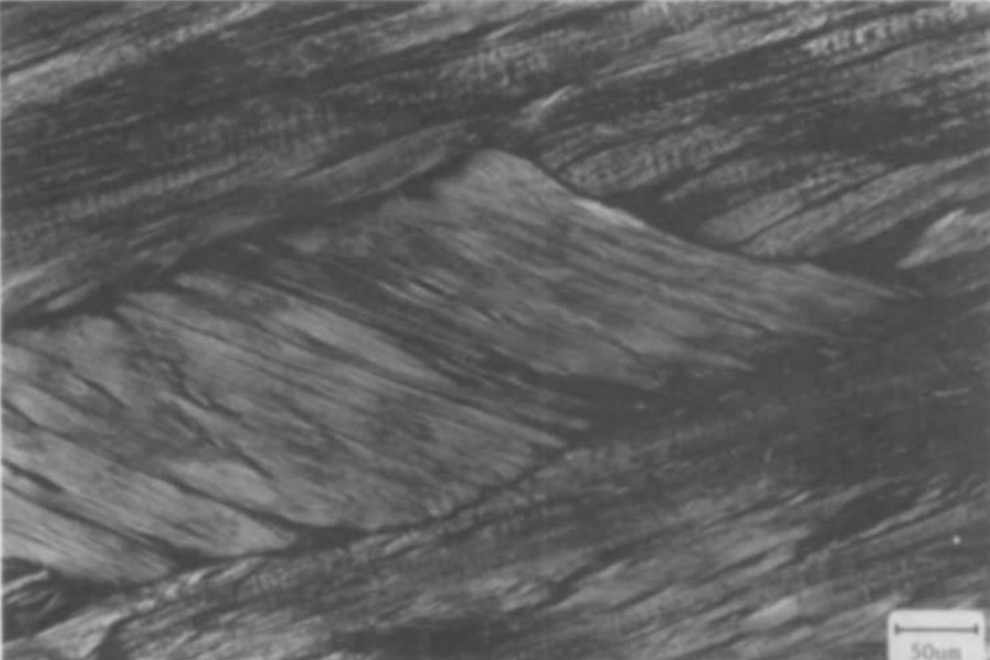
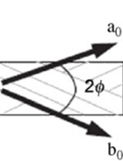
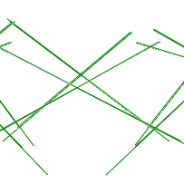
Annular Collagen Fibers
Two layers of connectors to represent approximately 20 layers of fibers in the disc; The angle of fiber orientation increases from about 20 degrees at the periphery to 45 degrees in the lamellae closest to the nucleus; (Cassidy et al. 1989)
The volume of the fibers is approximately 19% of the surrounding annulus. (Shirazi-adl et al. 1986; Ohshima et al. 1989)
Two different angles
Notes:
Pooni, J. S., Hukins, D. W., Harris, P. F., Hilton, R. C., & Davies, K. E. (1986). Comparison of the structure of human intervertebral discs in the cervical, thoracic and lumbar regions of the spine. Surgical and radiologic anatomy: SRA, 8(3), 175-182.
Wang, J. L., Parnianpour, M., Shirazi-Adl, A., Engin, A. E., Li, S., & Patwardhan, A. (1997). Development and validation of a viscoelastic finite element model of an L2/L3 motion segment. Theoretical and applied fracture mechanics, 28(1), 81-93.

Slide 10
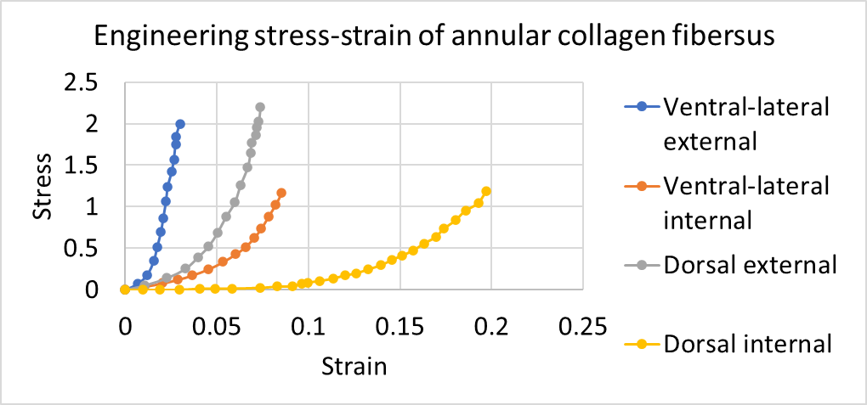
Annular Collagen Fibers (cont.)
Use tension-only nonlinear connectors;
20 connectors in each layer and total volume of two layers of connectors is 19% of the annulus volume;
Nonlinear stress–strain responses of fibers in four anatomical regions of the anulus fibrosus: Holzapfel et al. (2005)
90º
Ventral-lateral internal
Ventral-lateral external
Dorsal external
Dorsal internal

Slide 11
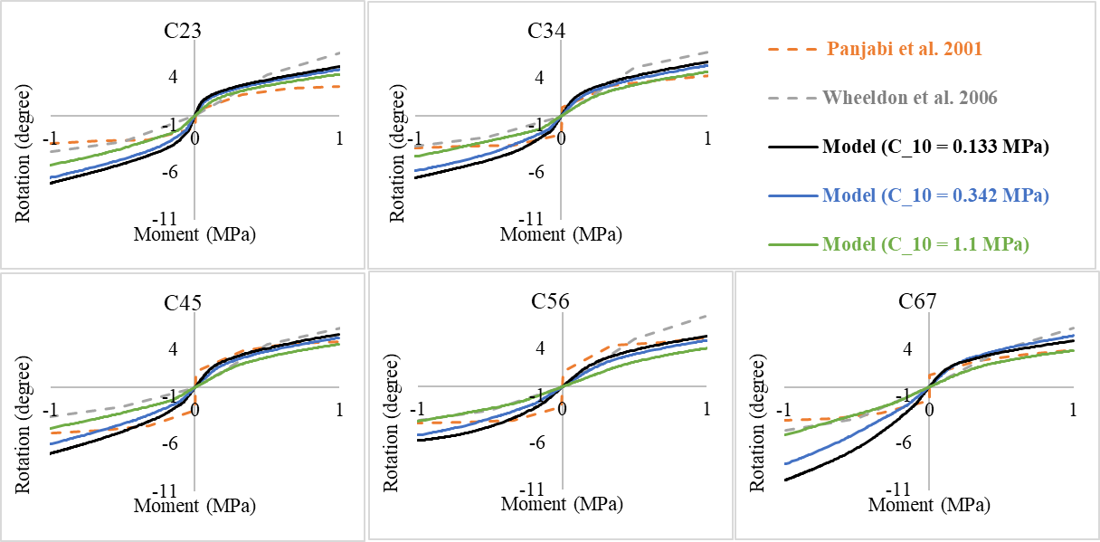
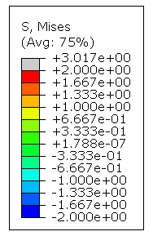
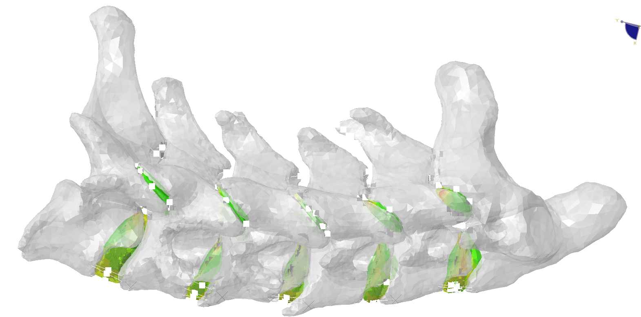
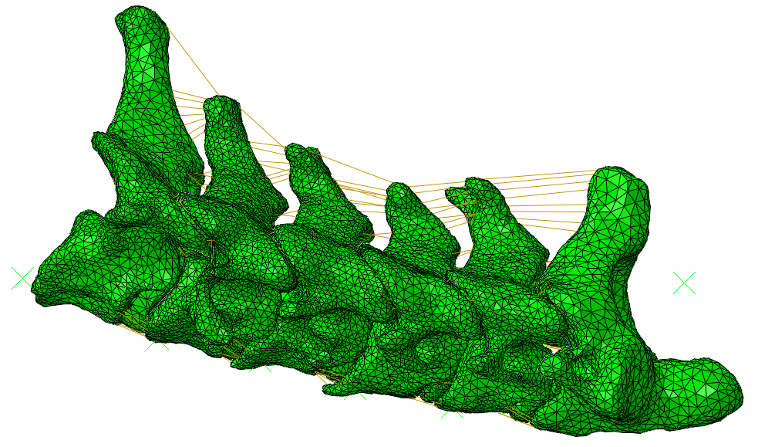
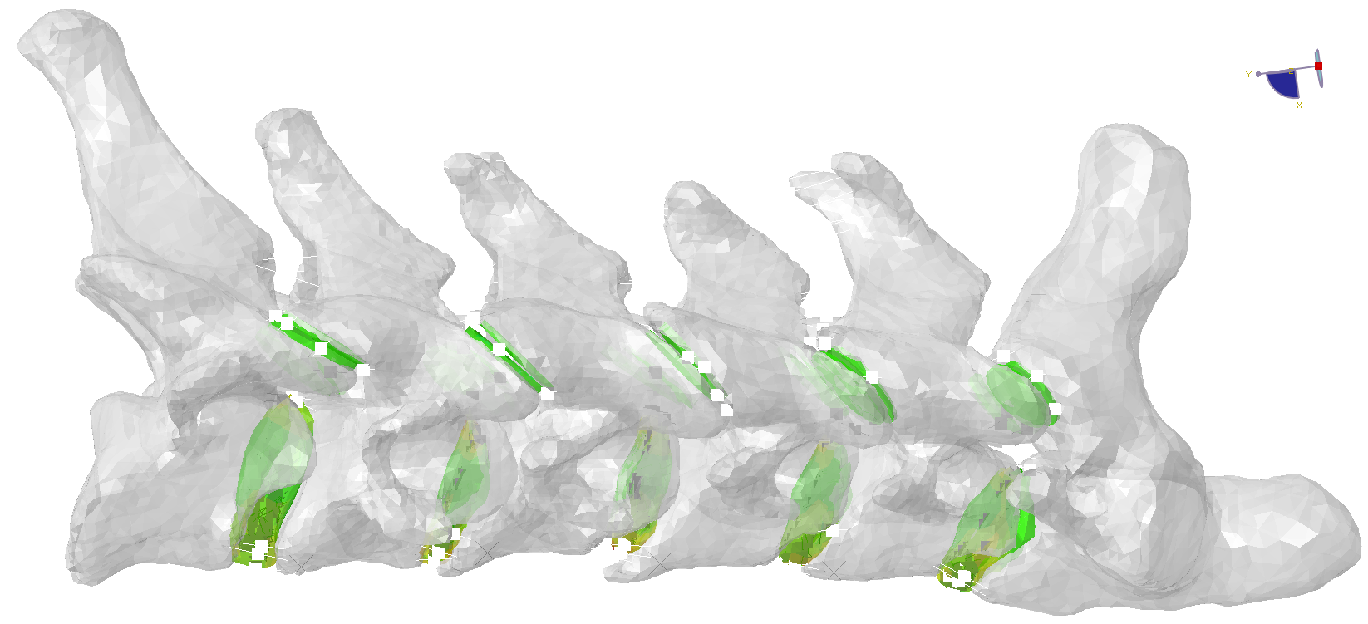
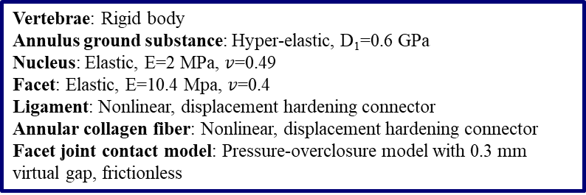
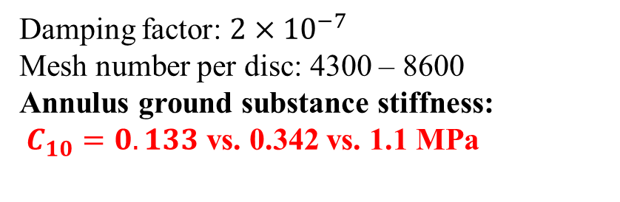
Cadaver Validation
Vertebrae: Rigid body
Annulus ground substance: Hyper-elastic, D₁=0.6 GPa
Nucleus: Elastic, E=2 MPa, $v$=0.49
Facet: Elastic, E=10.4 Mpa, $v$=0.4
Ligament: Nonlinear, displacement hardening connector
Annular collagen fiber: Nonlinear, displacement hardening connector
Facet joint contact model: Pressure-overclosure model with 0.3 mm virtual gap, frictionless
Damping factor: $2×10^{−7}$
Mesh number per disc: 4300 – 8600
Annulus ground substance stiffness:
$C_{10}=0.133$ vs. 0.342 vs. 1.1 MPa
Extension Flexion
-1 N·m
1 N·m
Fixed
Fixed
Fixed

Slide 12
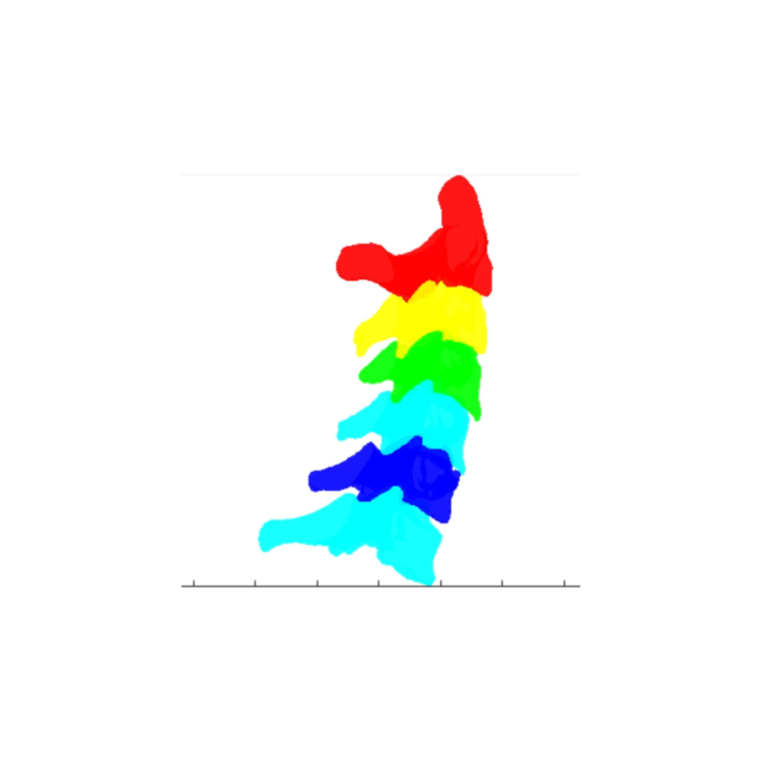
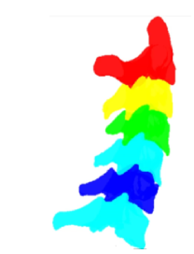
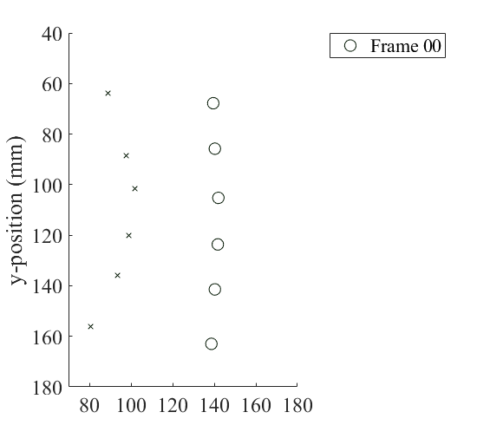
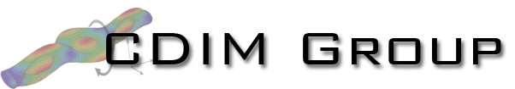
Comparison with In Vivo Data
In vivo experimental kinematics
Reference points used for the optimization objective
Initial position of reference points
x
x
x
x
x
x

Slide 13
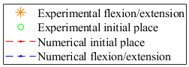
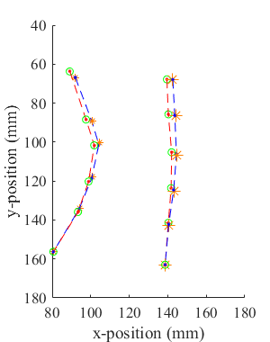
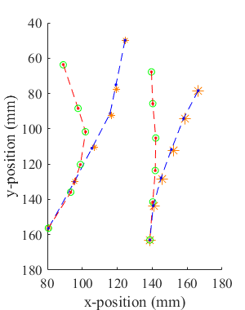
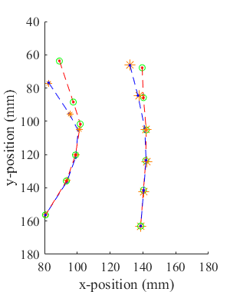
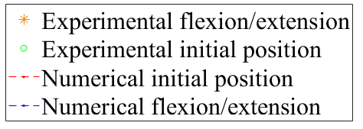
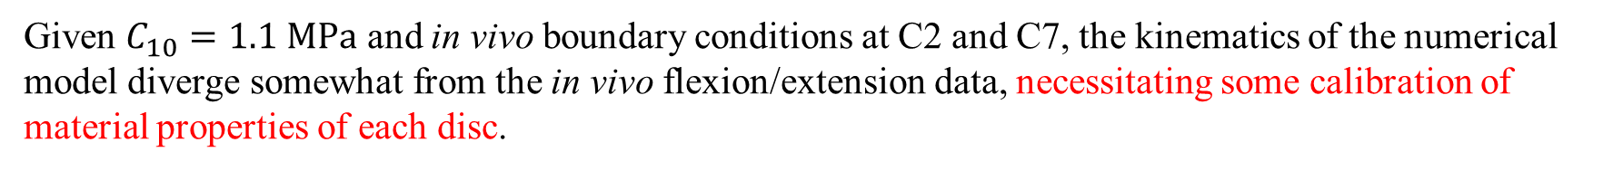
Initial Experimental-Numerical Comparison
Small flexion
Large flexion
Extension
Given $C_{10}=1.1 MPa$ and in vivo boundary conditions at C2 and C7, the kinematics of the numerical model diverge somewhat from the in vivo flexion/extension data, necessitating some calibration of material properties of each disc.

Slide 14
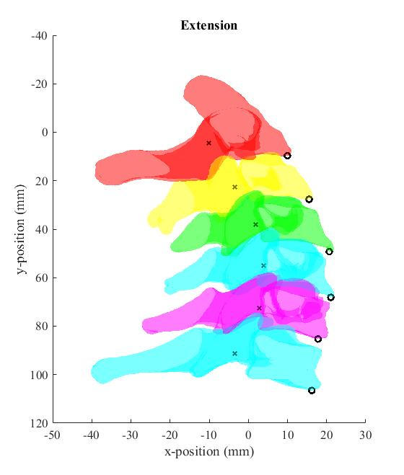
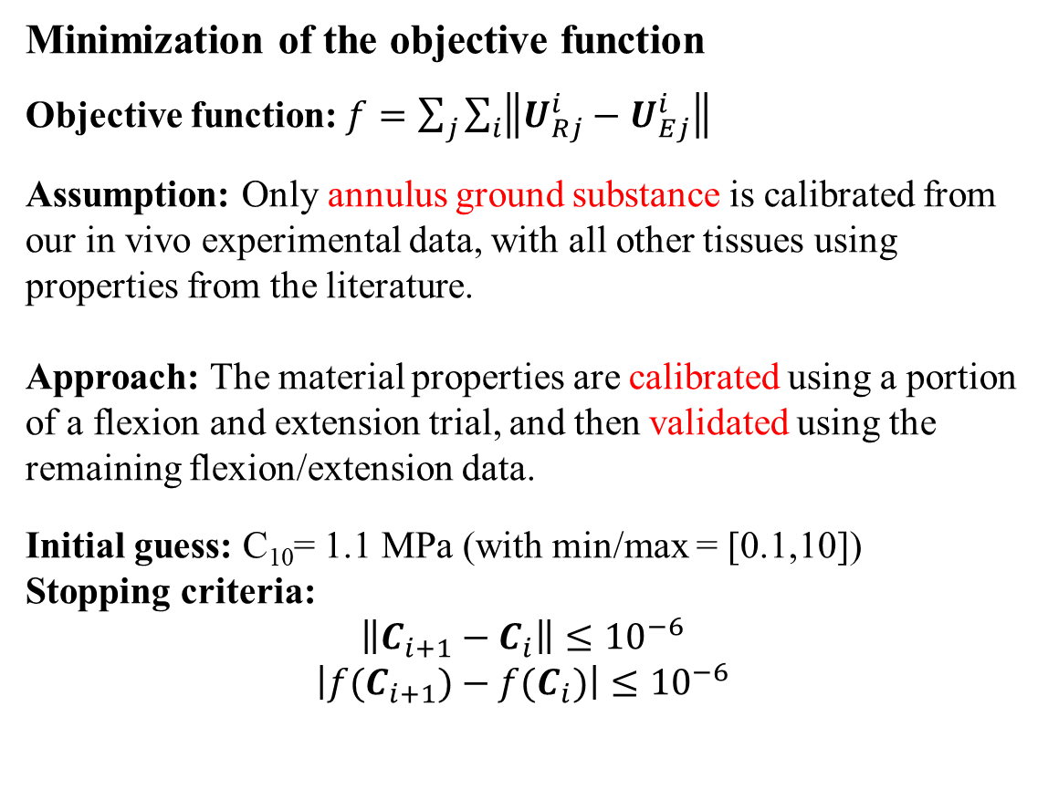
Inverse Material Estimation (Calibration) Process
Minimization of the objective function
Objective function:$f=\sum_{j}{\sum_{i}{\left\|U_{Rj}^{i}−U_{Ej}^{i}\right\|}}$
Assumption: Only annulus ground substance is calibrated from our in vivo experimental data, with all other tissues using properties from the literature.
Approach: The material properties are calibrated using a portion of a flexion and extension trial, and then validated using the remaining flexion/extension data.
Initial guess: C₁₀= 1.1 MPa (with min/max = [0.1,10])
Stopping criteria:
$$\left\|C_{i+1}−C_{i}\right\|≤10^{−6}$$
$$\left|{f(C}_{i+1})−{f(C}_{i})\right|≤10^{−6}$$
x
x
x
x
x
x

Slide 15
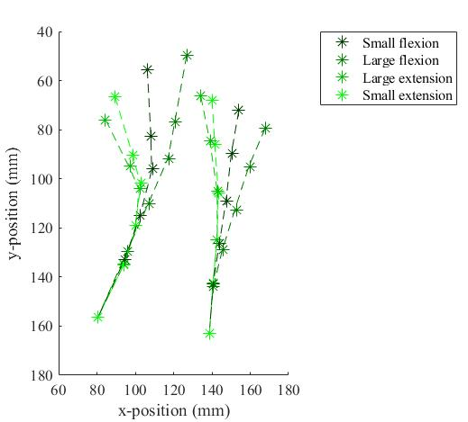
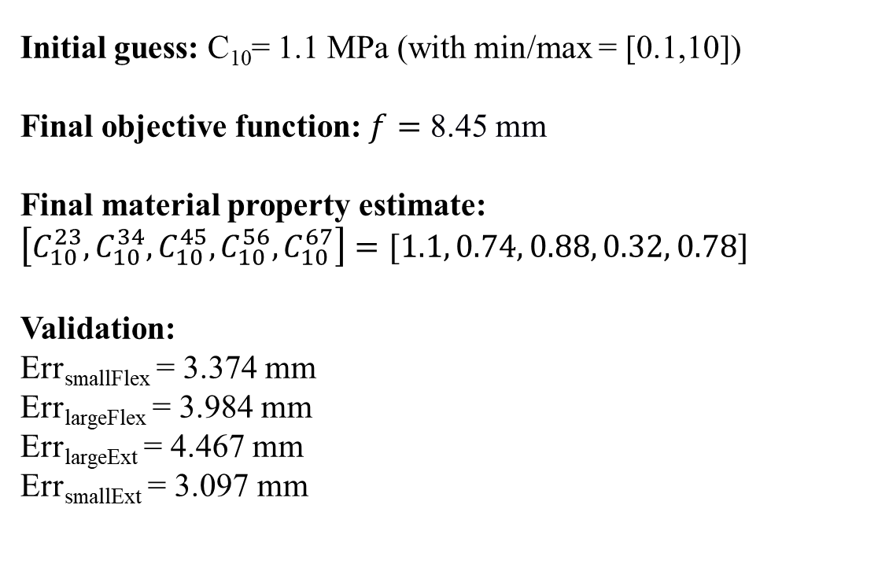
Inverse Material Estimation – Preliminary Results
Initial guess: C₁₀= 1.1 MPa (with min/max = [0.1,10])
Final objective function:$f=$ 8.45 mm
Final material property estimate:
$$\left[C_{10}^{23},C_{10}^{34},C_{10}^{45},C_{10}^{56},C_{10}^{67}\right]=[1.1, 0.74, 0.88, 0.32, 0.78]$$
Validation:
Err_{smallFlex} = 3.374 mm
Err_{largeFlex} = 3.984 mm
Err_{largeExt} = 4.467 mm
Err_{smallExt} = 3.097 mm

Slide 16
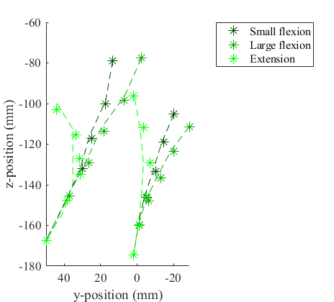
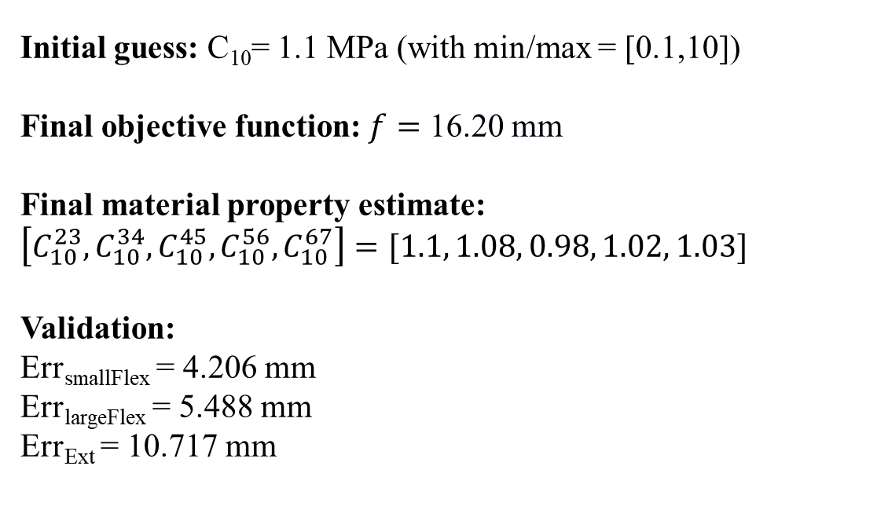
Inverse Material Estimation – Control Subject
Initial guess: C₁₀= 1.1 MPa (with min/max = [0.1,10])
Final objective function:$f=$ 16.20 mm
Final material property estimate:
$$\left[C_{10}^{23},C_{10}^{34},C_{10}^{45},C_{10}^{56},C_{10}^{67}\right]=[1.1, 1.08, 0.98, 1.02, 1.03]$$
Validation:
Err_{smallFlex} = 4.206 mm
Err_{largeFlex} = 5.488 mm
Err_{Ext} = 10.717 mm

Slide 17
Conclusions and Future Directions
A computational approach was established to model subject-specific cervical spines, including realistic geometries from CT imaging and nonlinear tissue properties from the literature.
The kinematic behavior of the model was validated through comparison with corresponding results from in vitro experiments in the literature.
A calibration procedure is proposed to estimate the material properties of each intervertebral disc, by minimizing the difference of kinematics between the numerical model and our in vivo experiments.
Future work includes:
execution/refinement of the calibration procedure, including consideration of alternate motion trials and loading options.
further upgrading model components/realism and eventually incorporating arthrodesis.

Slide 18


Acknowledgements
Soumaya Ouhsousou, Clarissa M. LeVasseur, Jeremy Shaw, William Anderst, and John C. Brigham
Support from the Cervical Spine Research Society (CSRS)

Slide 19
References
del Palomar, A. P., Calvo, B., & Doblare, M. (2008). An accurate finite element model of the cervical spine under quasi-static loading. Journal of biomechanics, 41(3), 523-531.
Ha, S. K. (2006). Finite element modeling of multi-level cervical spinal segments (C3–C6) and biomechanical analysis of an elastomer-type prosthetic disc. Medical engineering & physics, 28(6), 534-541.
Chazal, J., Tanguy, A., Bourges, M., Gaurel, G., Escande, G., Guillot, M., & Vanneuville, G. (1985). Biomechanical properties of spinal ligaments and a histological study of the supraspinal ligament in traction. Journal of biomechanics, 18(3), 167-176.
Yoganandan, N., Kumaresan, S., & Pintar, F. A. (2000). Geometric and mechanical properties of human cervical spine ligaments. J. Biomech. Eng., 122(6), 623-629.
Panzer, M. B., & Cronin, D. S. (2009). C4–C5 segment finite element model development, validation, and load-sharing investigation. Journal of biomechanics, 42(4), 480-490.
Mengoni, M. (2021). Biomechanical modelling of the facet joints: a review of methods and validation processes in finite element analysis. Biomechanics and Modeling in Mechanobiology, 20(2), 389-401.
Pooni, J. S., Hukins, D. W., Harris, P. F., Hilton, R. C., & Davies, K. E. (1986). Comparison of the structure of human intervertebral discs in the cervical, thoracic and lumbar regions of the spine. Surgical and radiologic anatomy: SRA, 8(3), 175-182.
Iatridis, J. C., Setton, L. A., Weidenbaum, M., & Mow, V. C. (1997). The viscoelastic behavior of the non-degenerate human lumbar nucleus pulposus in shear. Journal of biomechanics, 30(10), 1005-1013.

Slide 20
References
Wang, J. L., Parnianpour, M., Shirazi-Adl, A., Engin, A. E., Li, S., & Patwardhan, A. (1997). Development and validation of a viscoelastic finite element model of an L2/L3 motion segment. Theoretical and applied fracture mechanics, 28(1), 81-93.
Wang, J. L., Parnianpour, M., Shirazi-Adl, A., & Engin, A. E. (2000). Viscoelastic finite-element analysis of a lumbar motion segment in combined compression and sagittal flexion: Effect of loading rate. Spine, 25(3), 310-318.
Wang, Z., Zhao, H., Liu, J. M., Tan, L. W., Liu, P., & Zhao, J. H. (2016). Resection or degeneration of uncovertebral joints altered the segmental kinematics and load-sharing pattern of subaxial cervical spine: A biomechanical investigation using a C2–T1 finite element model. Journal of biomechanics, 49(13), 2854-2862.
Cassidy, J. J., Hiltner, A., & Baer, E. (1989). Hierarchical structure of the intervertebral disc. Connective tissue research, 23(1), 75-88.
Shirazi-Adl, A., Ahmed, A. M., & Shrivastava, S. C. (1986). A finite element study of a lumbar motion segment subjected to pure sagittal plane moments. Journal of biomechanics, 19(4), 331-350.
OHSHIMA, H., TSUJI, H., HIRANO, N., ISHIHARA, H., KATOH, Y., & YAMADA, H. (1989). Water diffusion pathway, swelling pressure, and biomechanical properties of the intervertebral disc during compression load. Spine, 14(11), 1234-1244.
Holzapfel, G. A., Schulze-Bauer, C. A., Feigl, G., & Regitnig, P. (2005). Single lamellar mechanics of the human lumbar anulus fibrosus. Biomechanics and modeling in mechanobiology, 3, 125-140.

